Slide 1
Fantastic 4: Our Team
Our team, Fantastic 4, is dedicated to developing a reliable and innovative gas detection system. We have combined our expertise in electronics, software, and chemistry to create a solution that can effectively identify and measure different gases.
Swam Singla
Shubham Goel
Inesh Dheer
Shreyas Mehta

Slide 2
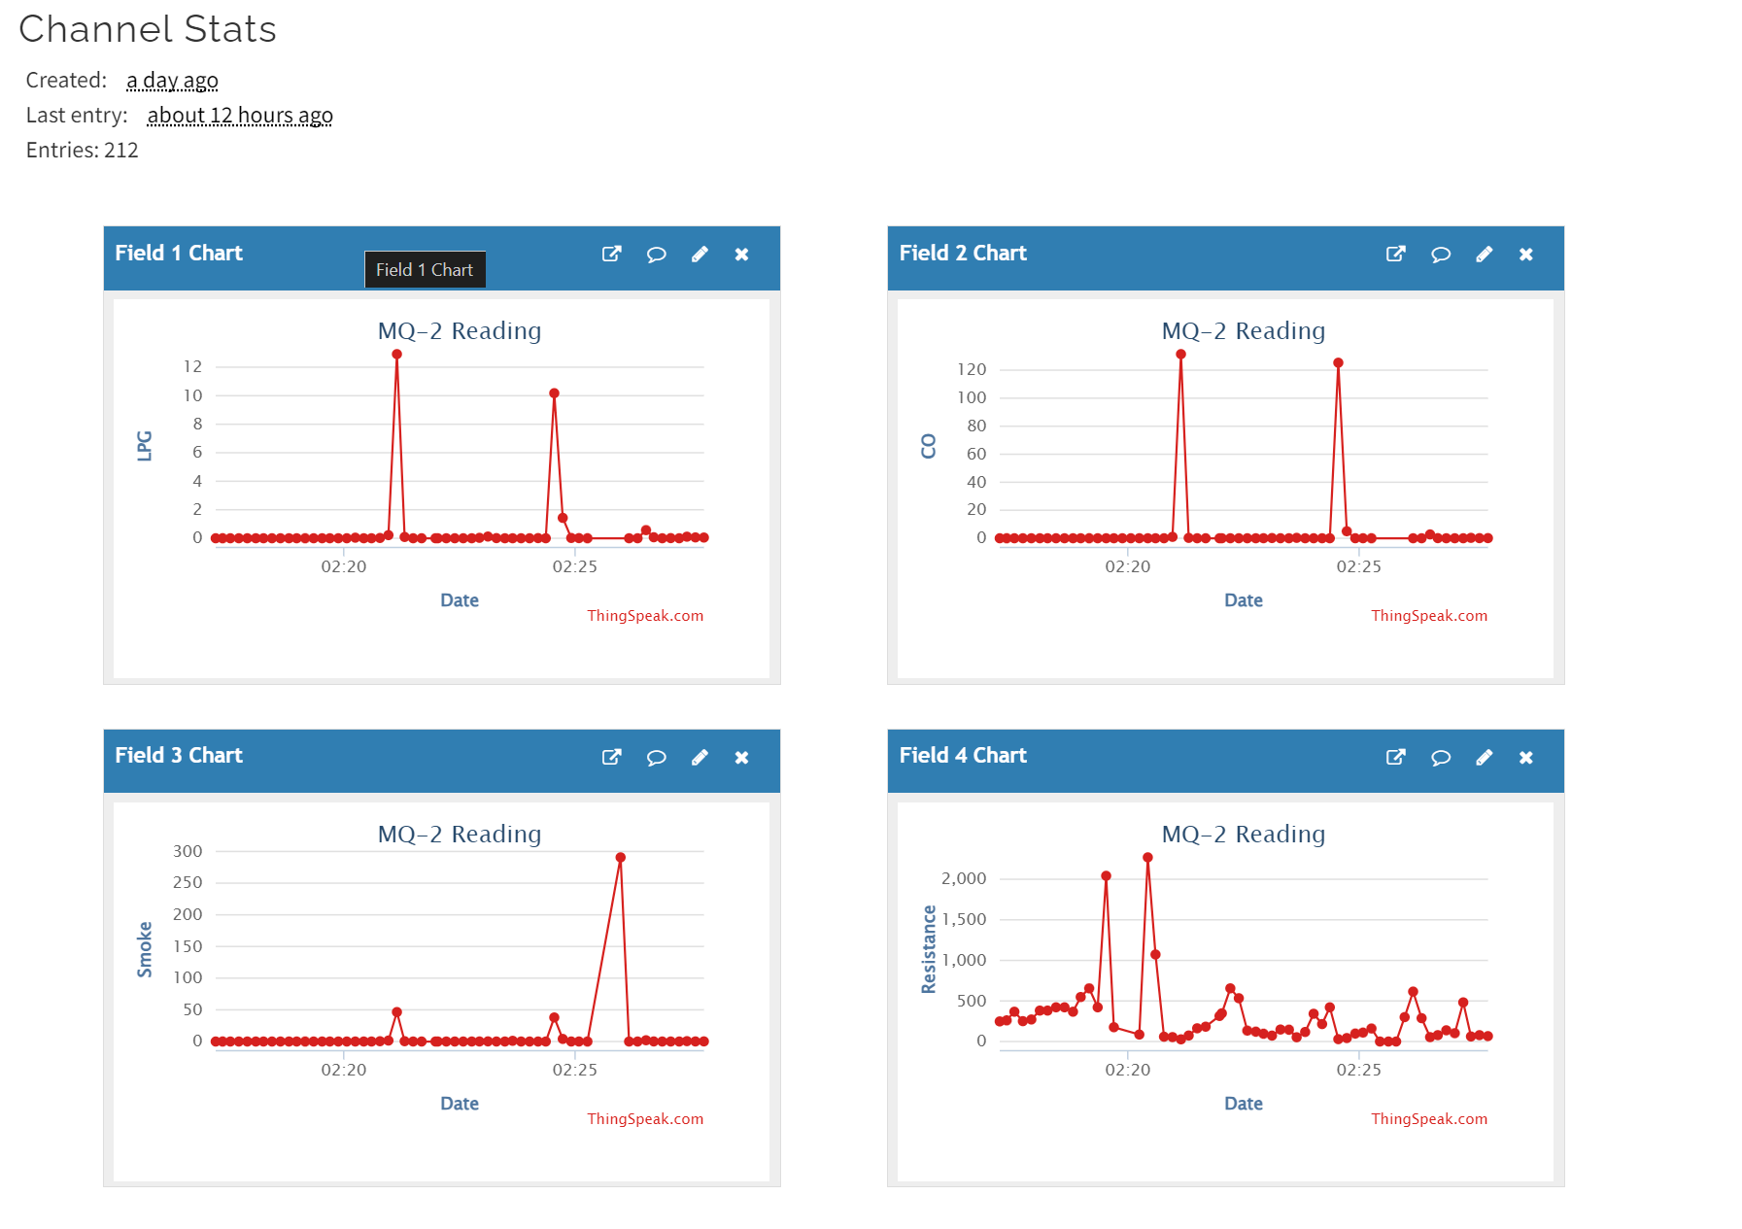
Week 1/2 - Data Collection (Raw Data)

Slide 3

Week 2 Report:
Inesh | Shreyas | Shubham | Swam
Wrote the main working code for the ESP32/MQ-2 sensor. Made and setup the ThingSpeak channel which in turn made the graphical analysis possible. Made this presentation. | Made Specific changes in code base (specifically header files) for shifting from Arduino to ESP32. Checked For Calibration Methods in datasheet along with specific variable analysis. Converted CSV data to graphically analyzable form. | Started working on the platform Figured out MQTT was successful in setting up “mosquito” broker and receiving data from ESP32 to flask server through the broker. | Datasheet analysis of MQ-2, calibrated ppm values using graphs of ppm vs log(rs/ro) given in datasheet. Analysis of data collected(LPG, smoke and CO).

Slide 4
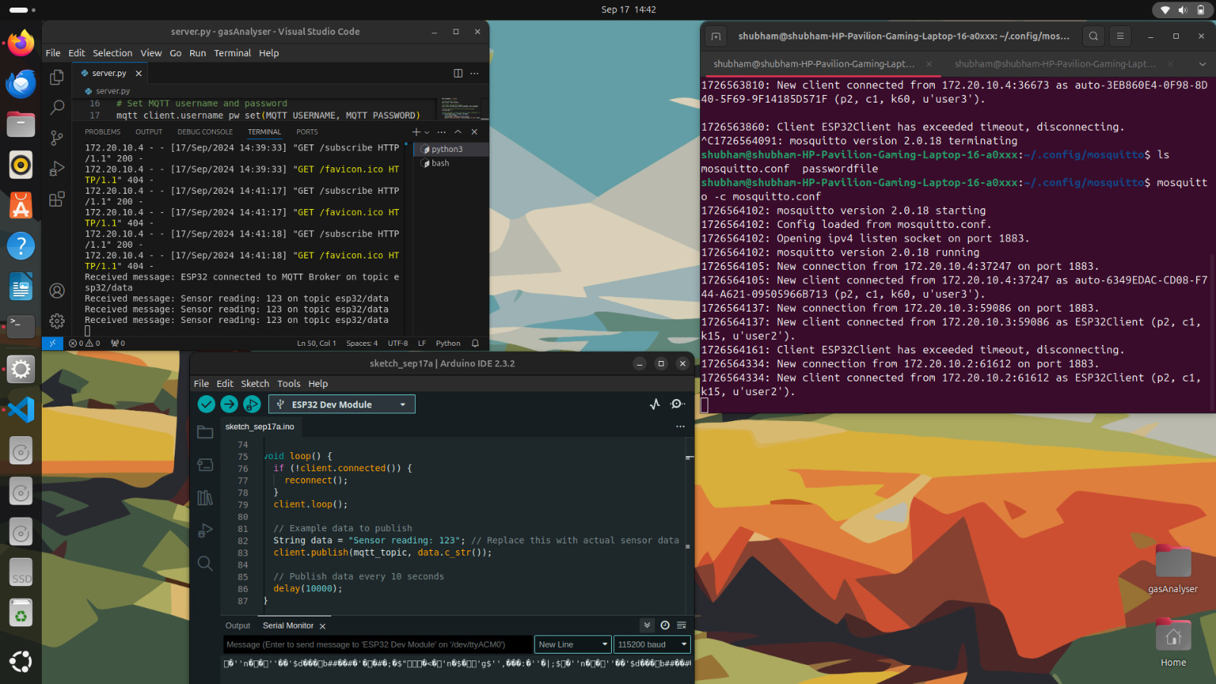

Slide 5
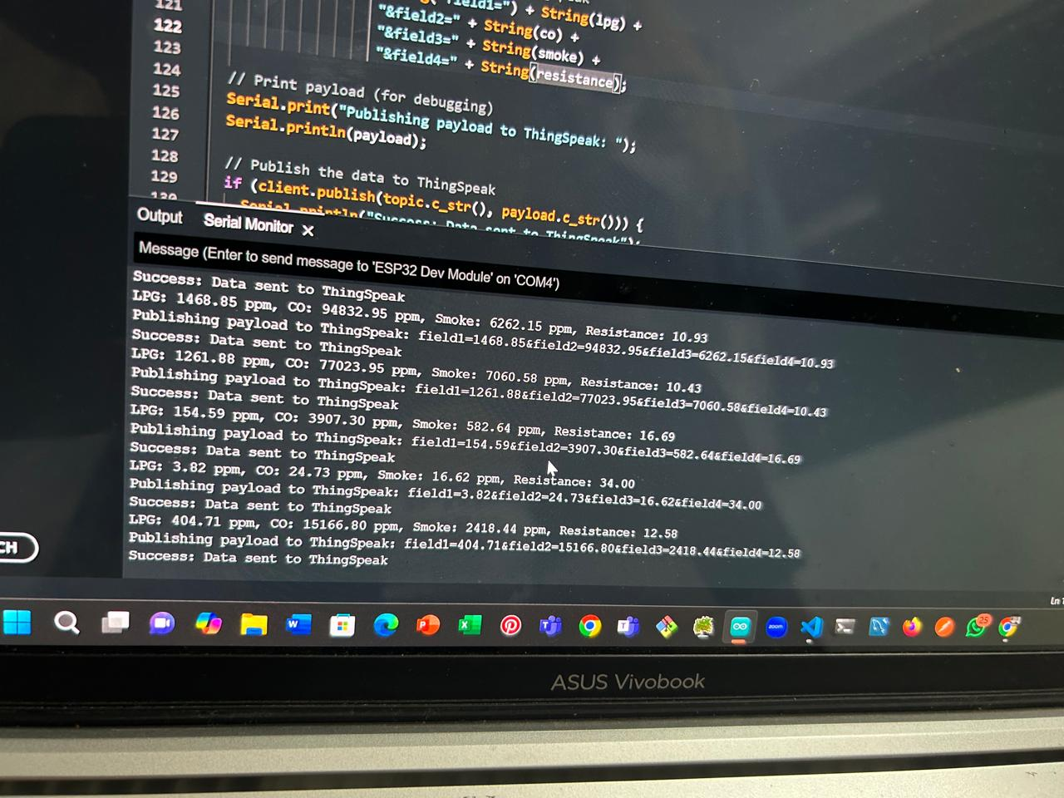
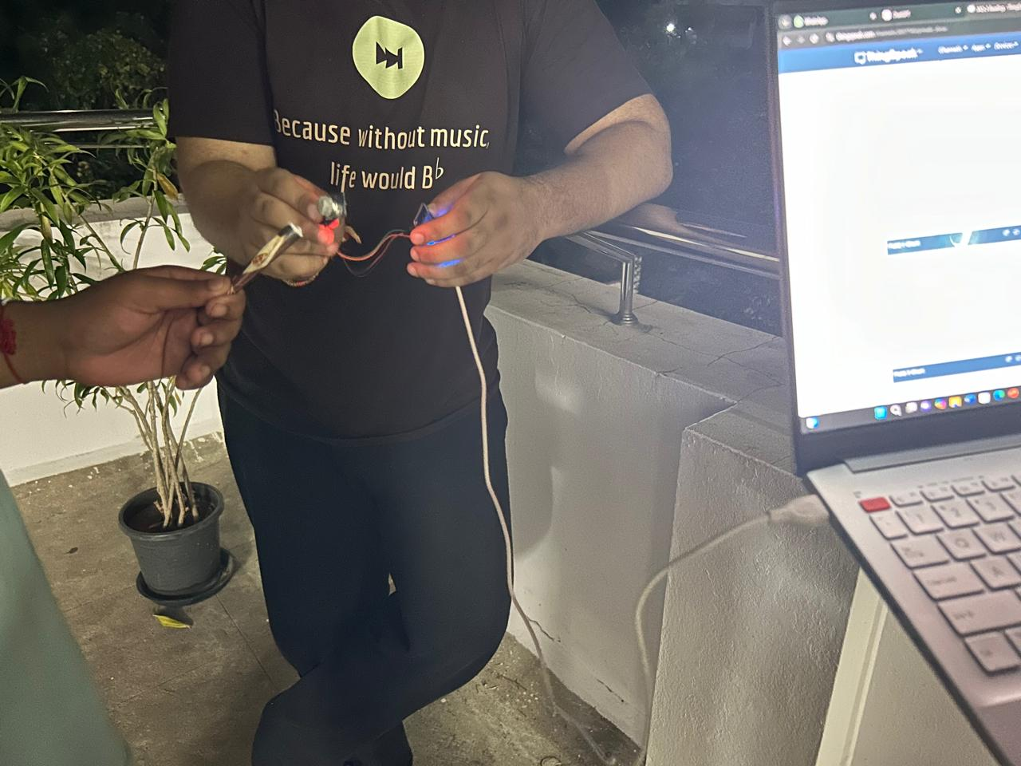
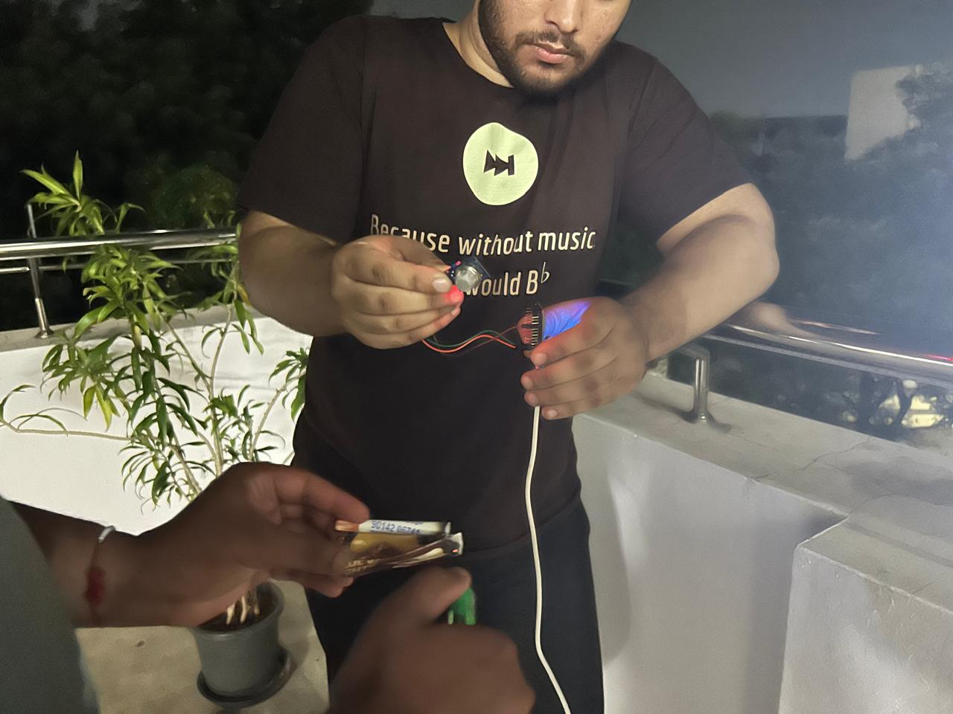
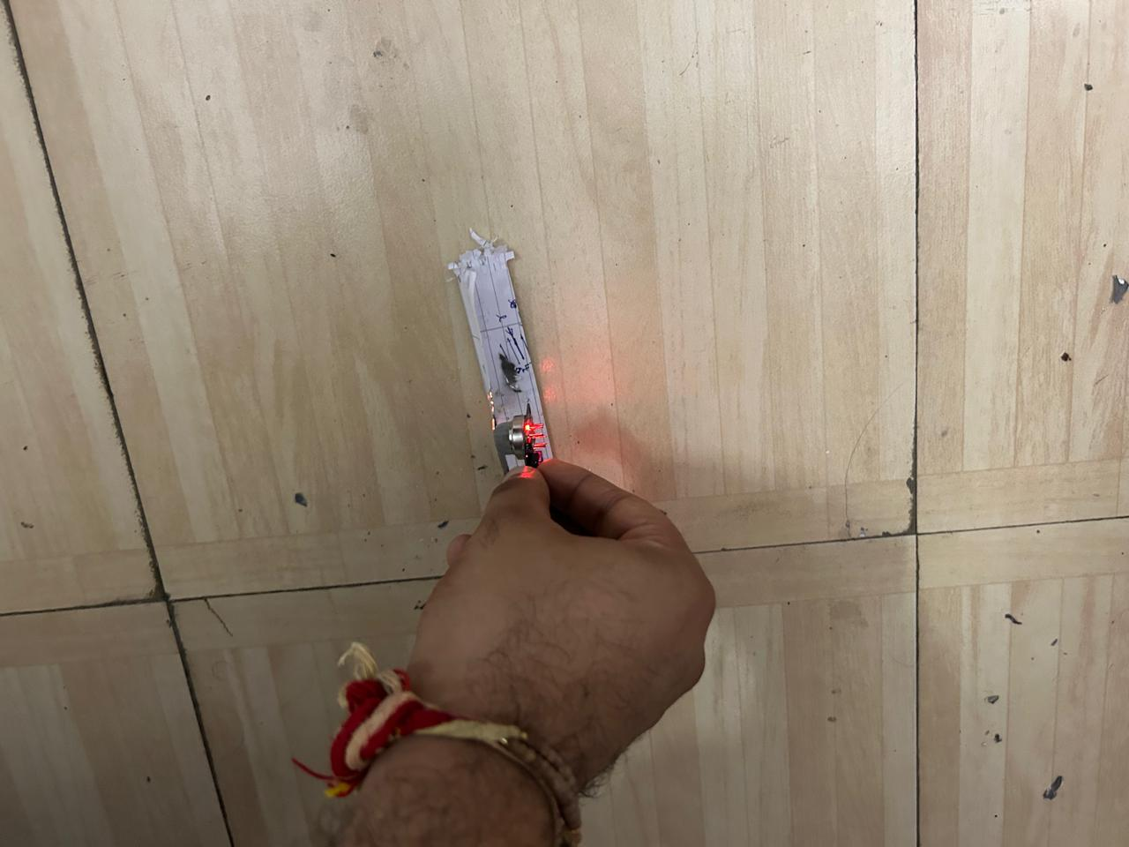
A glimpse of
our work

Slide 6
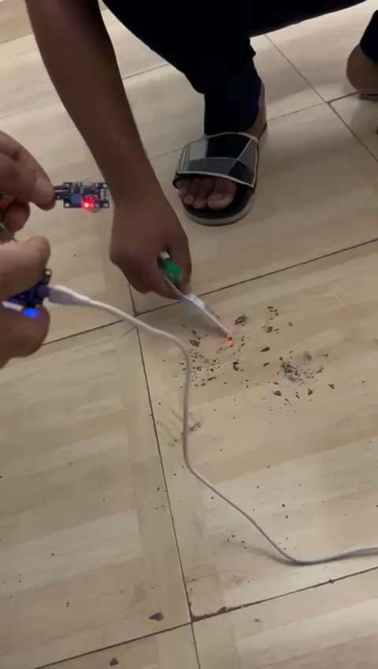

Slide 7
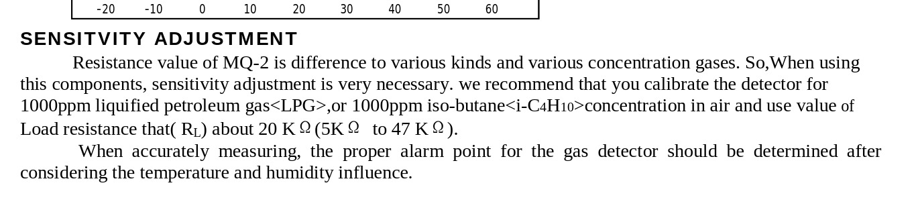
SITE : https://www.mouser.com/datasheet/2/321/605-00008-MQ-2-Datasheet-370464.pdf?srsltid=AfmBOoqtTlu7Vq4f_Cez8RST9gdqlQE1DE0eE3xeVSmNGci9Qd8Pf595
Header Site Reference: https://github.com/labay11/MQ-2-sensor-library

Slide 8
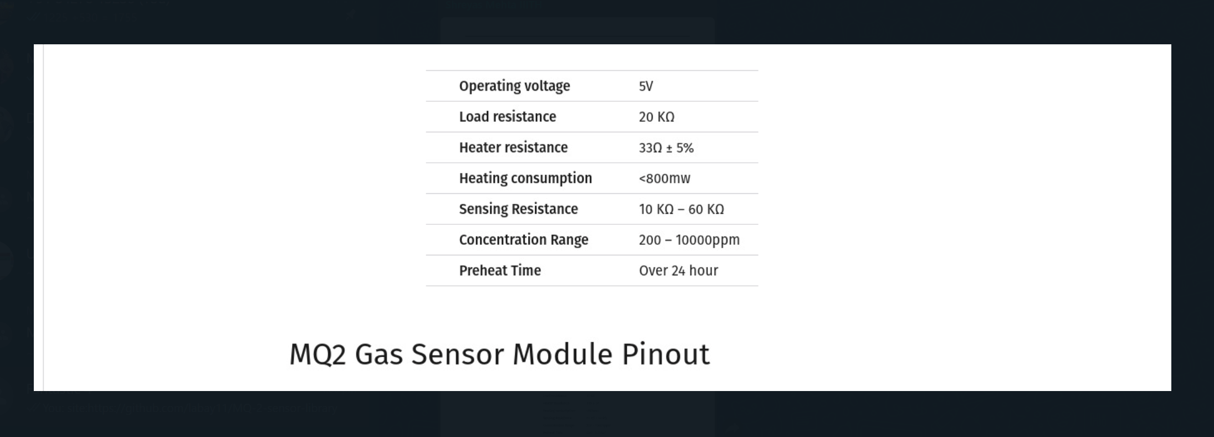
SITE:https://lastminuteengineers.com/mq2-gas-senser-arduino-tutorial/

Slide 9
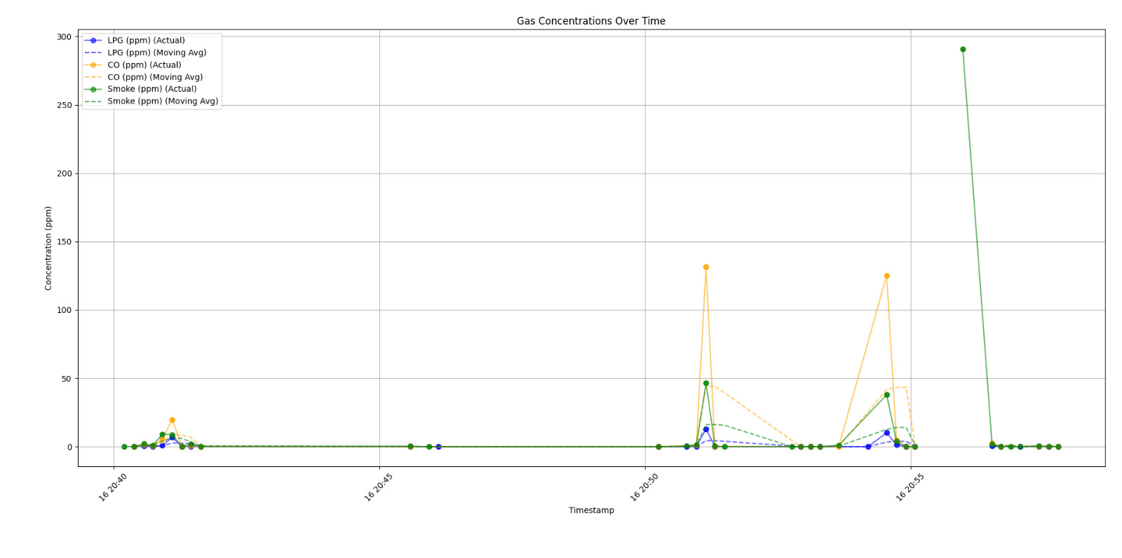

Slide 10
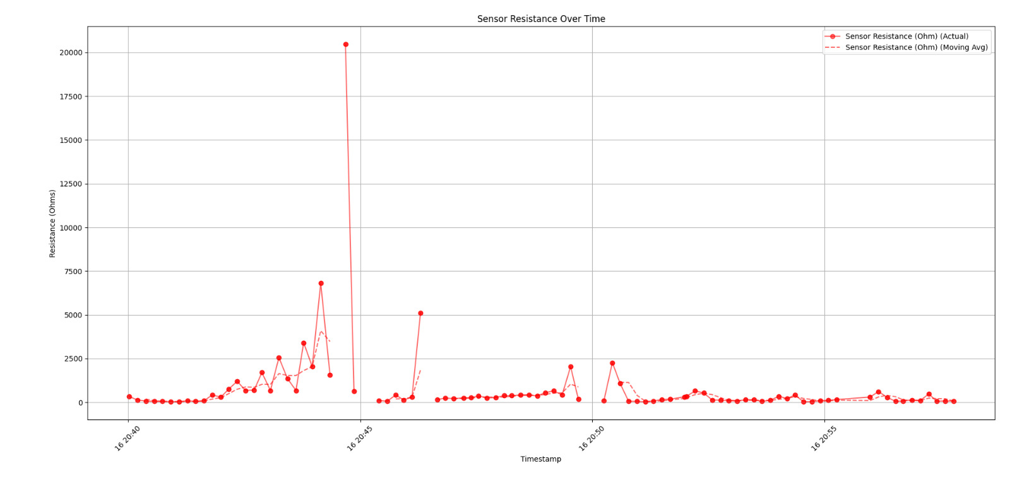

Slide 11
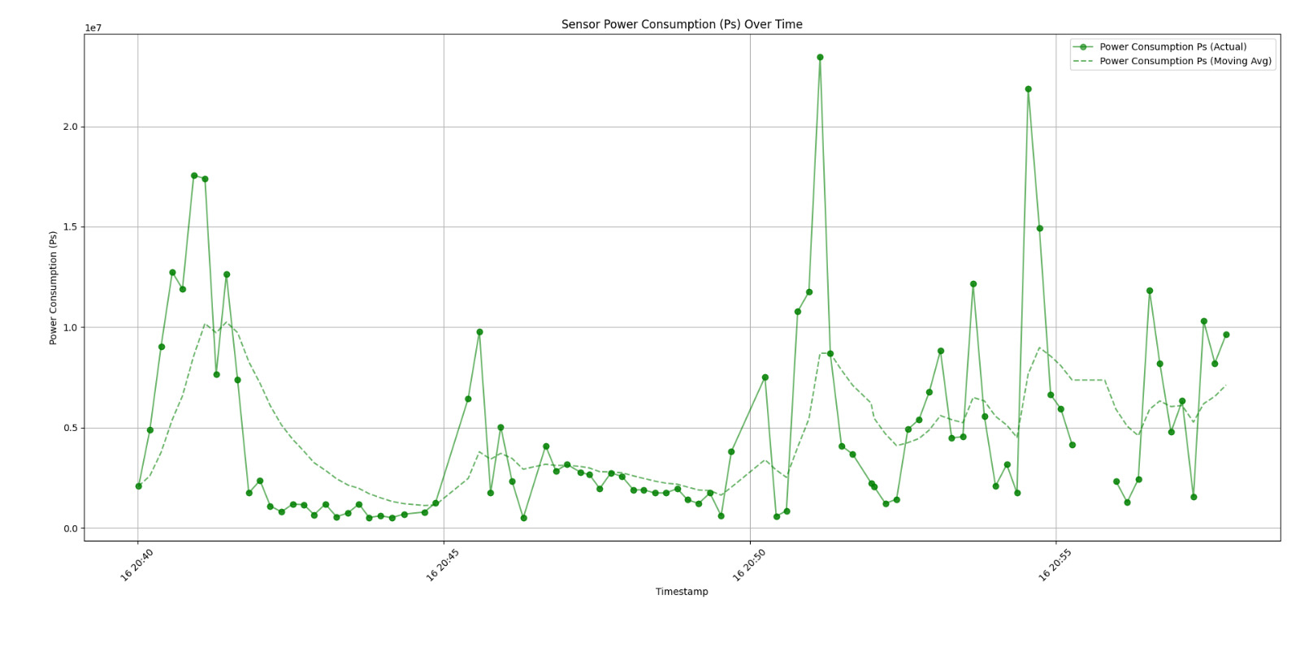
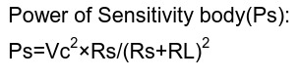

Slide 12
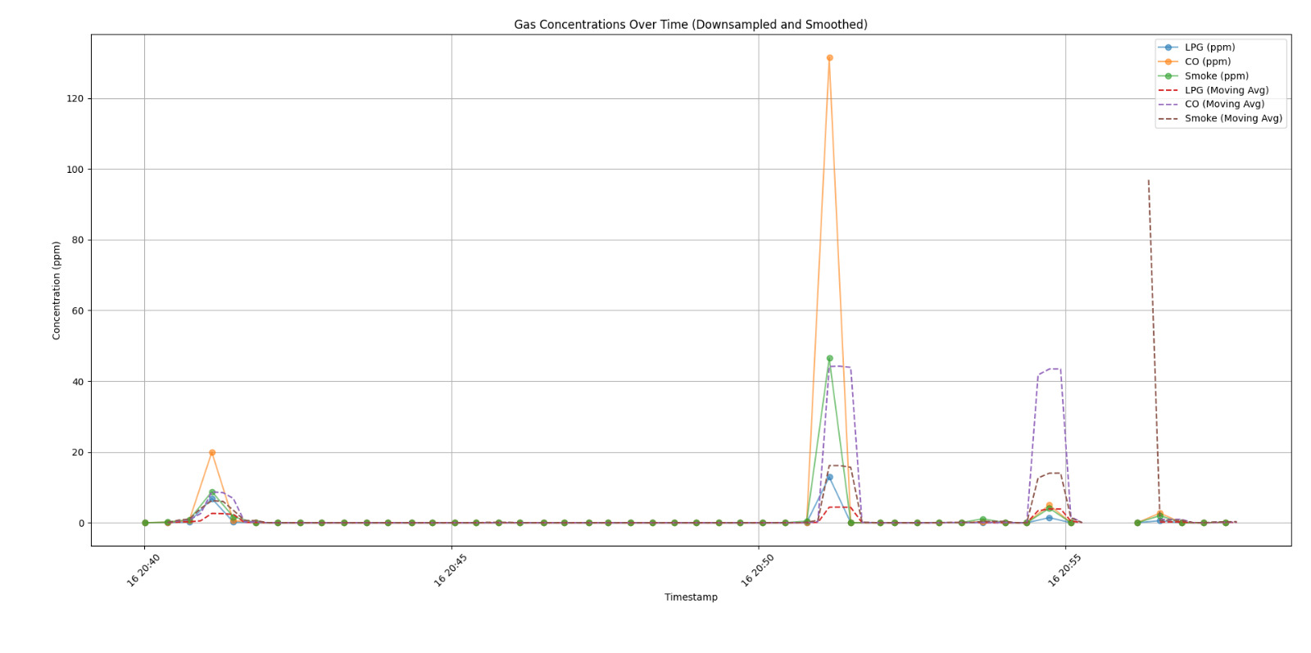

Slide 13
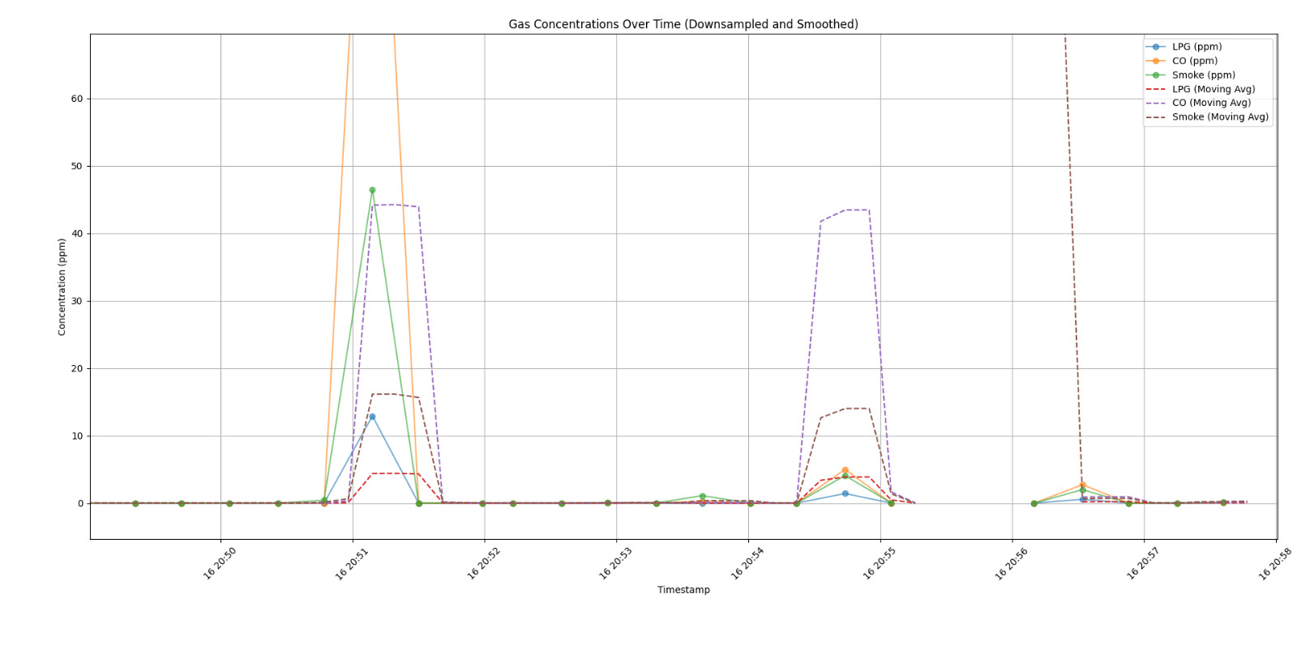

Slide 14
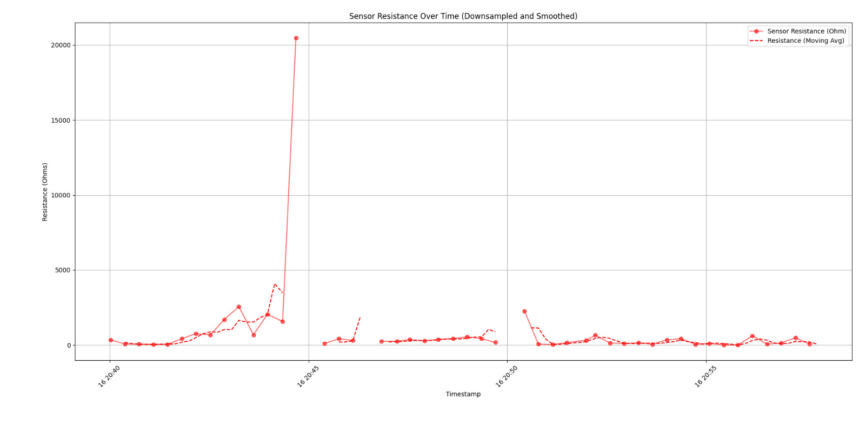

Slide 15
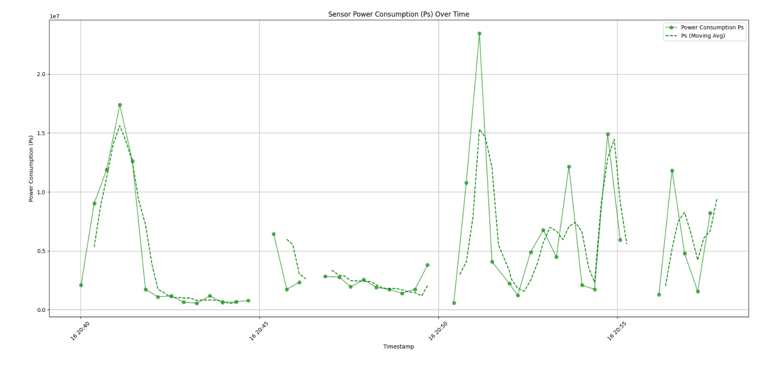

Slide 16
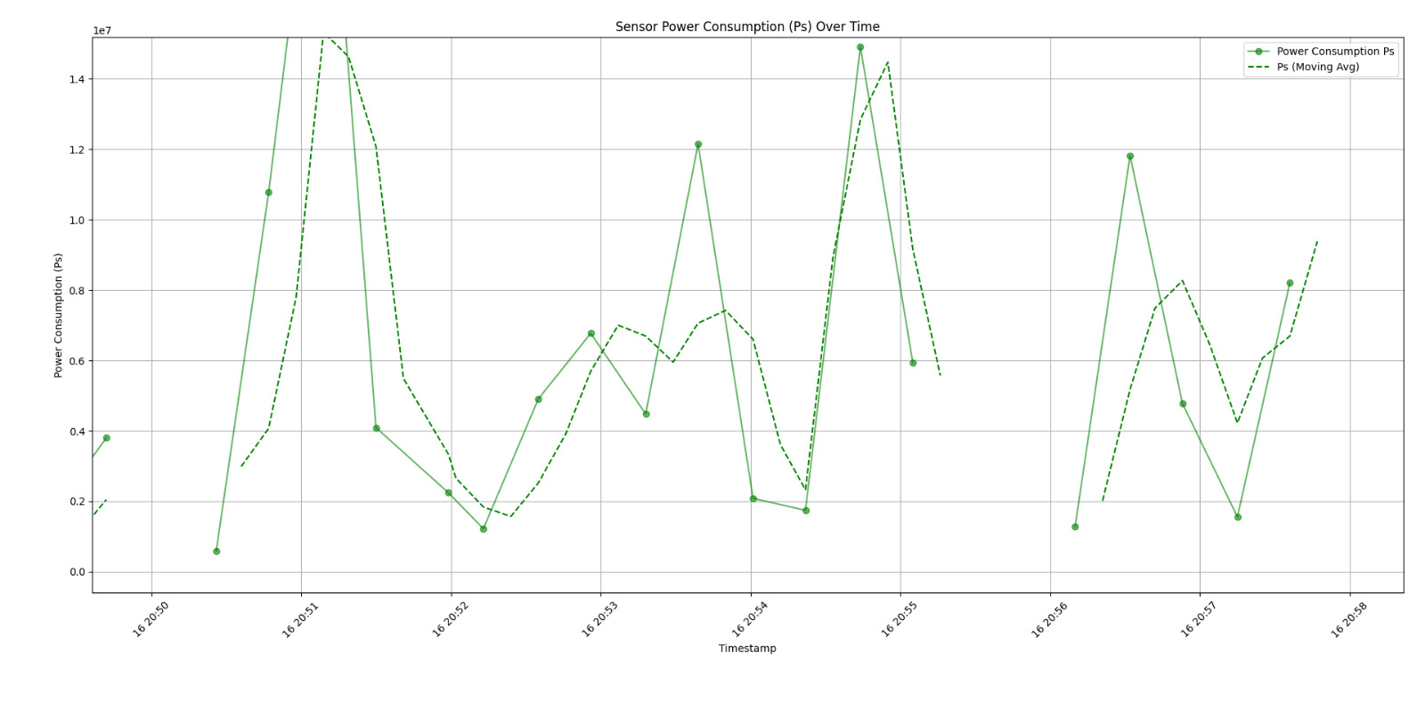

Slide 17
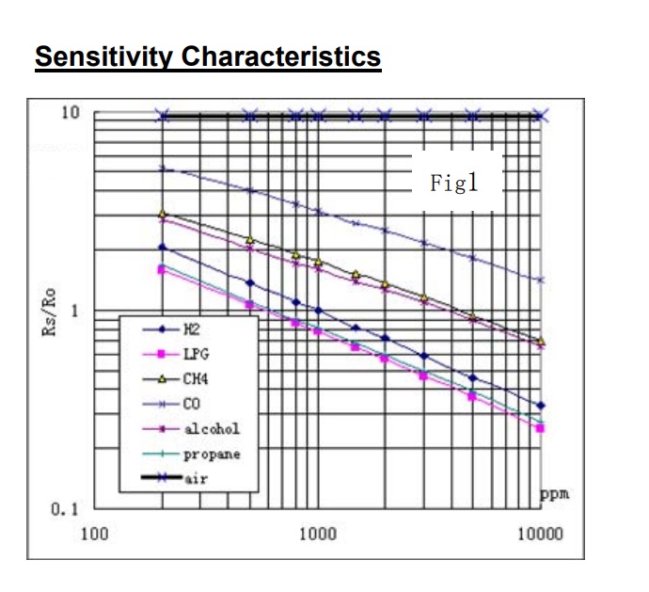
Site: https://www.pololu.com/file/0J309/MQ2.pdf

Slide 18
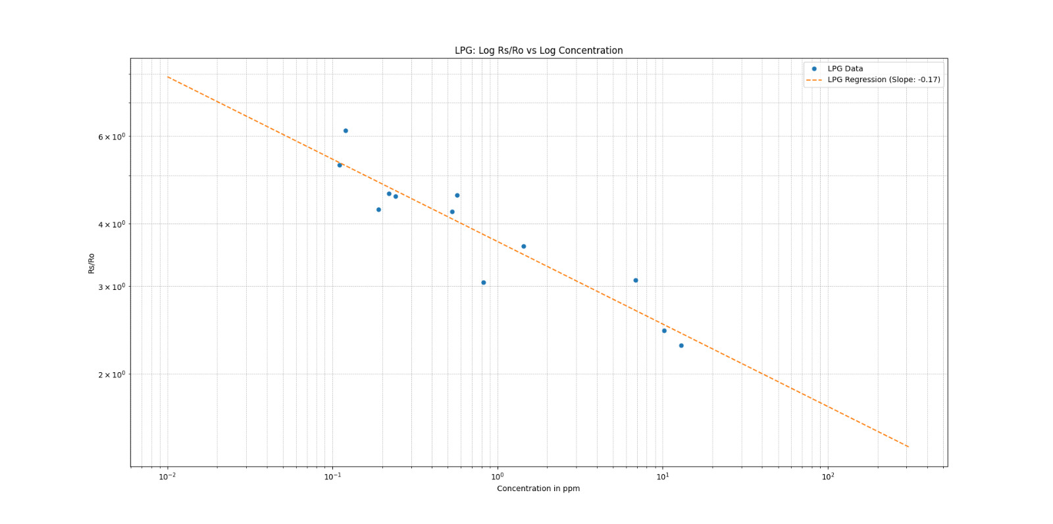

Slide 19
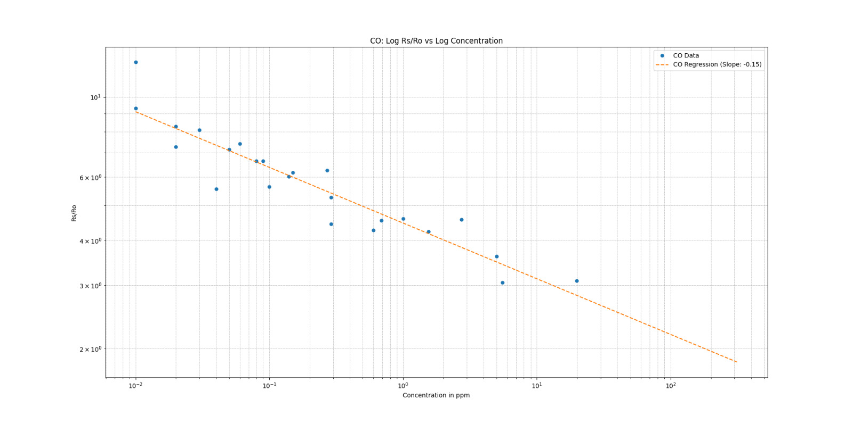

Slide 20
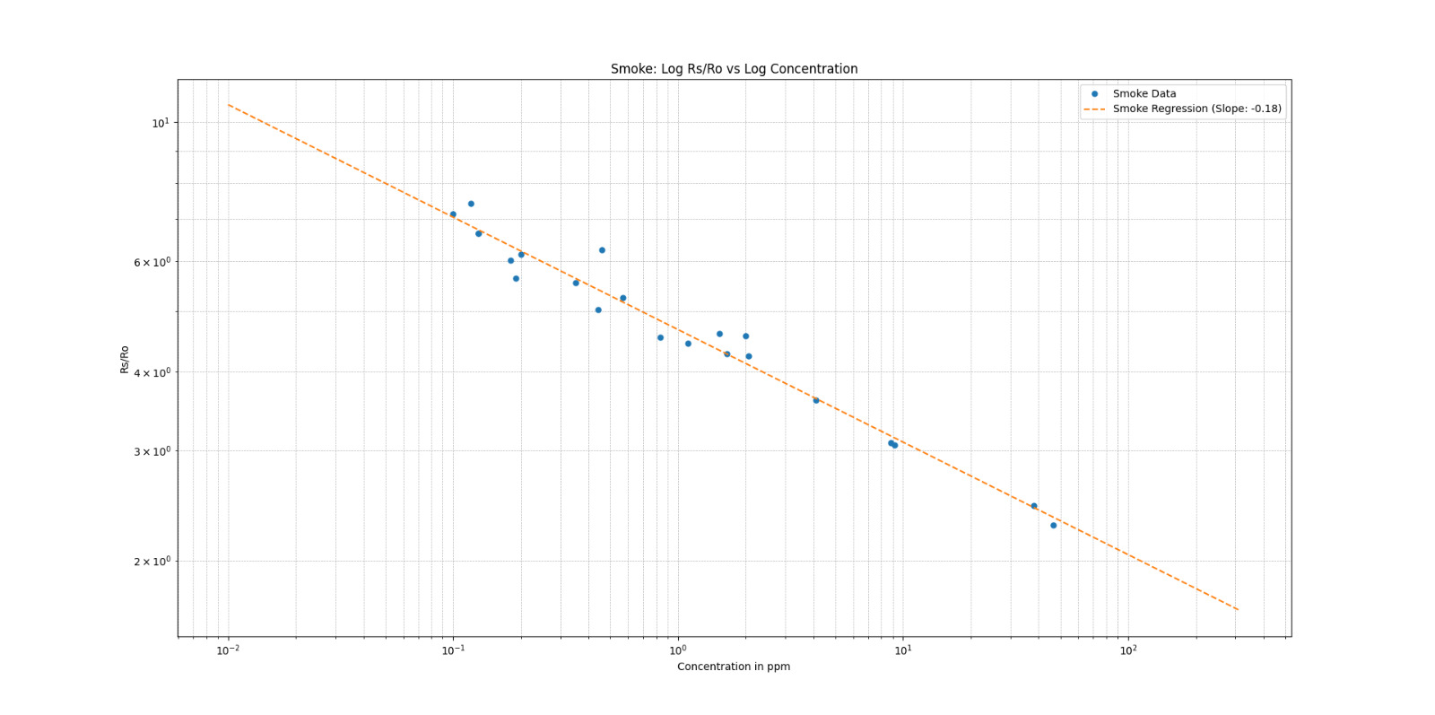

Slide 21
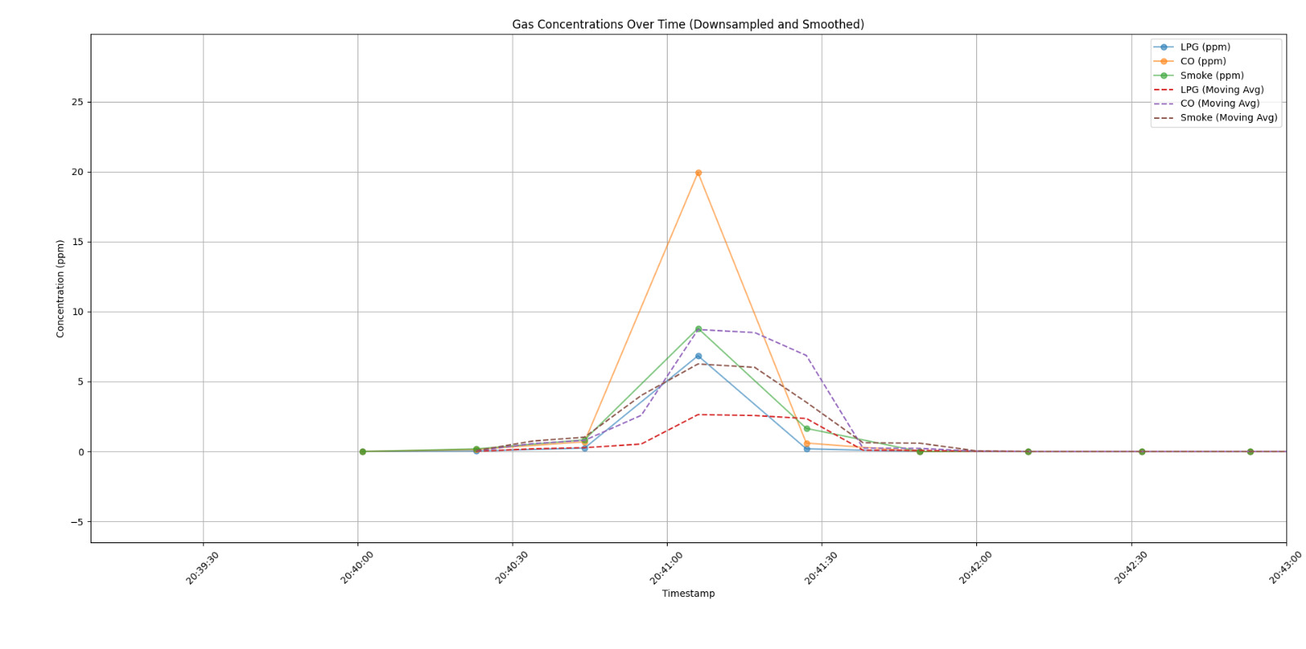
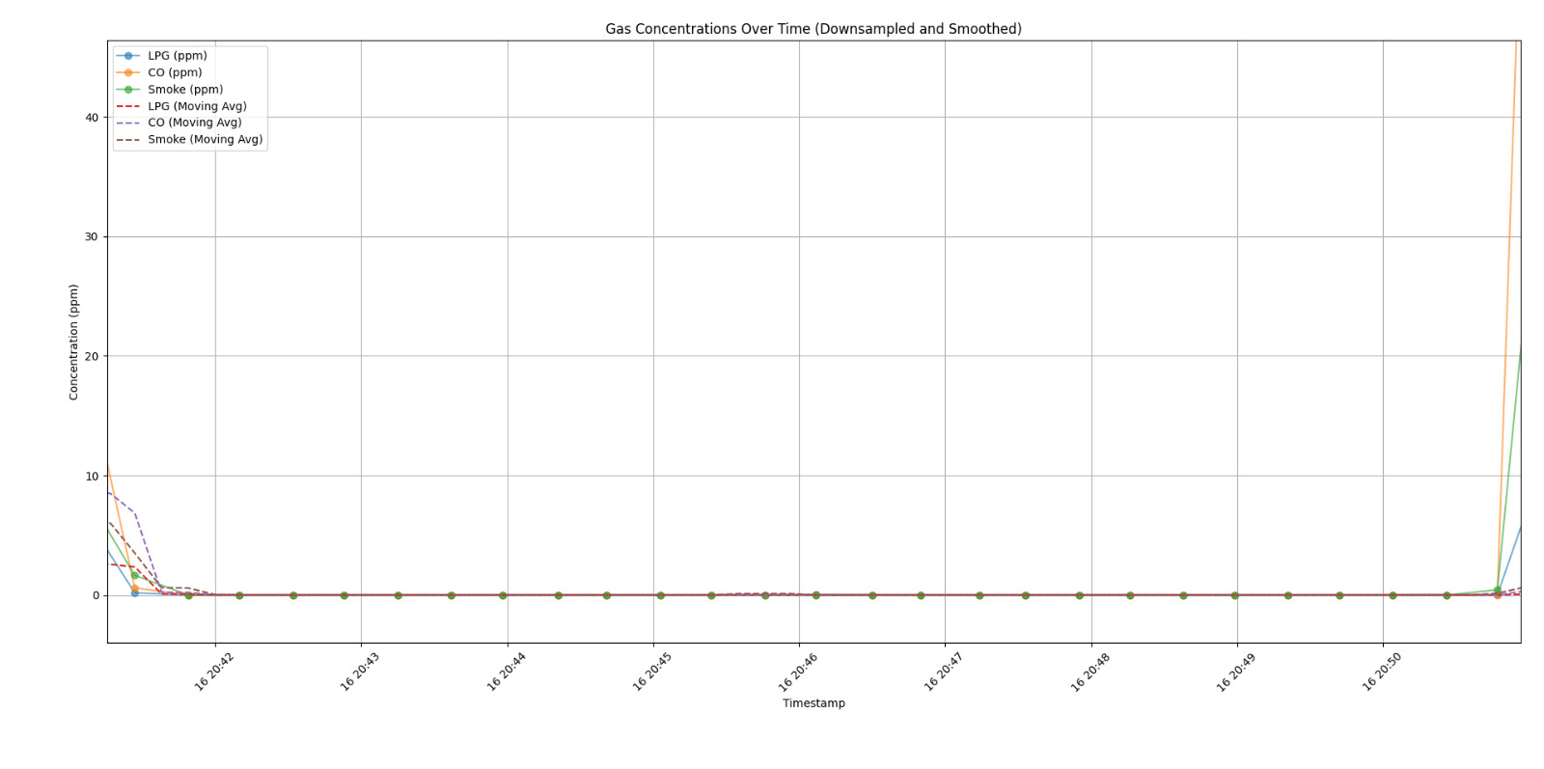
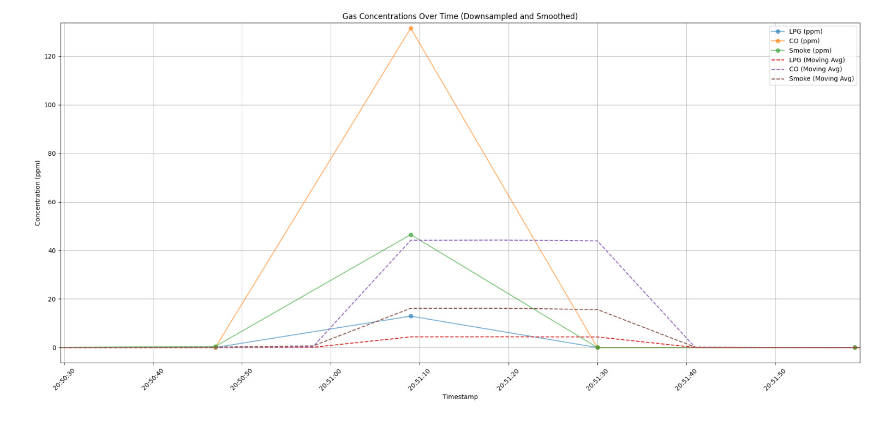
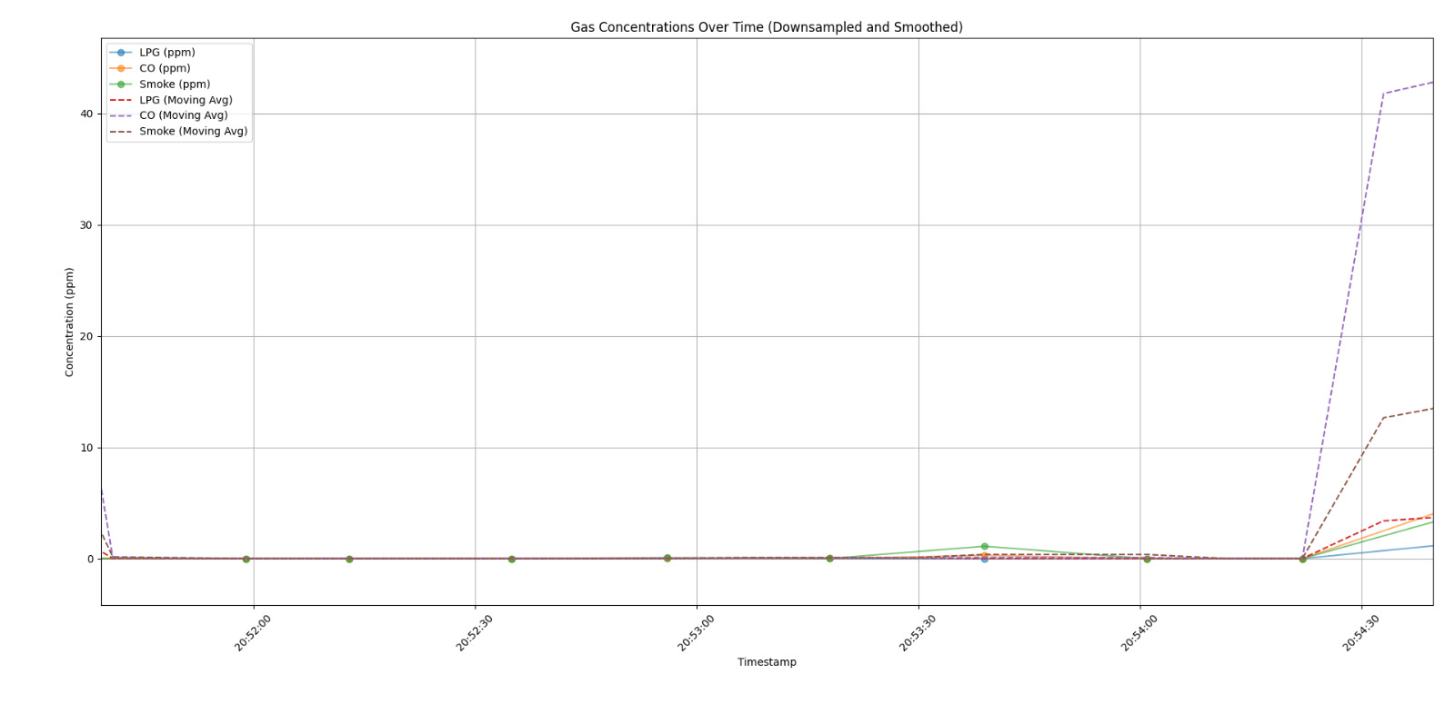

Slide 22
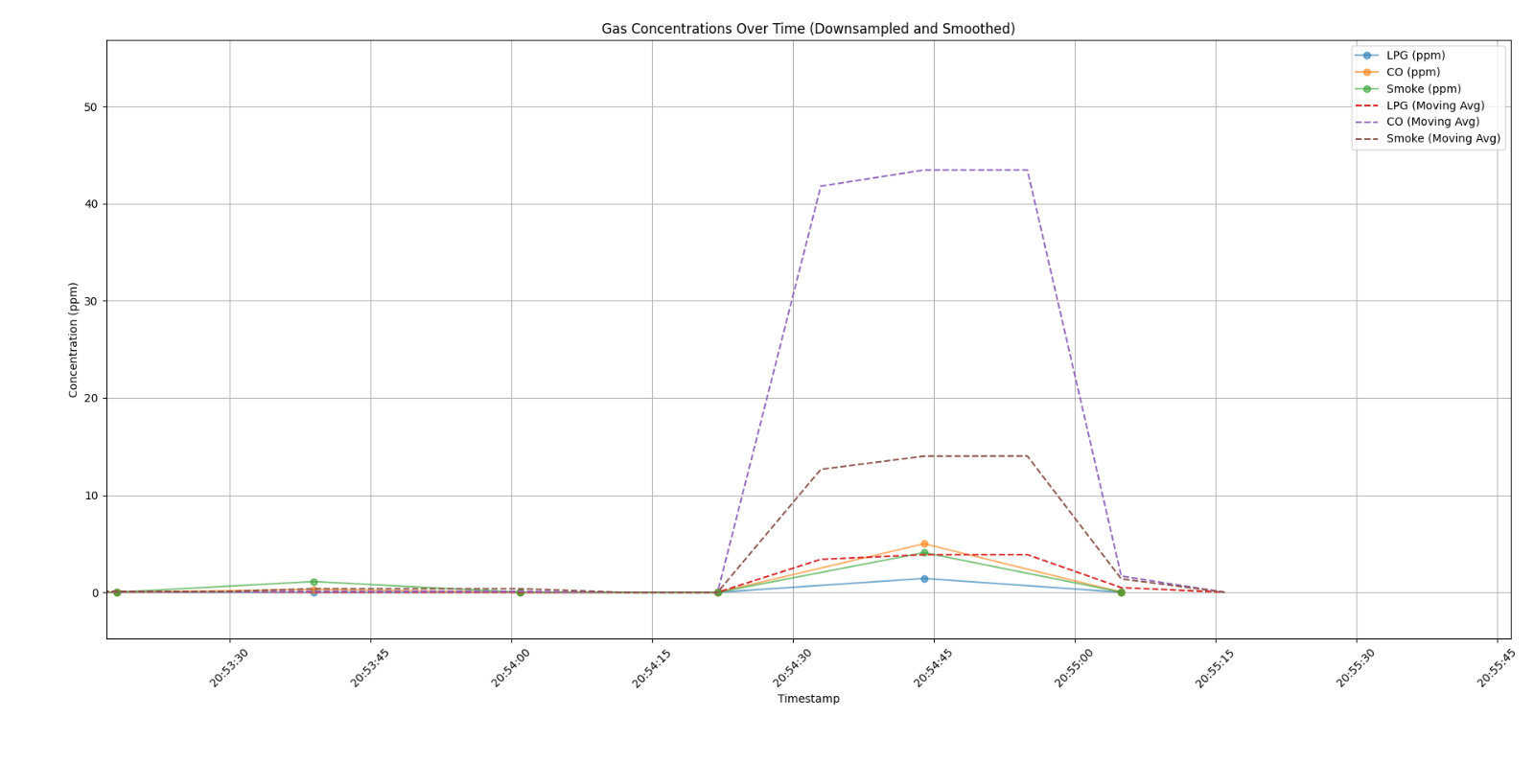
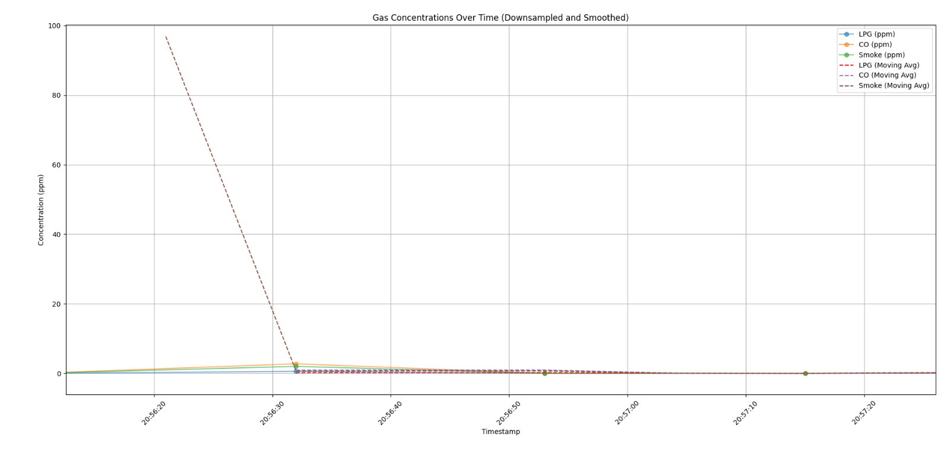

Slide 23
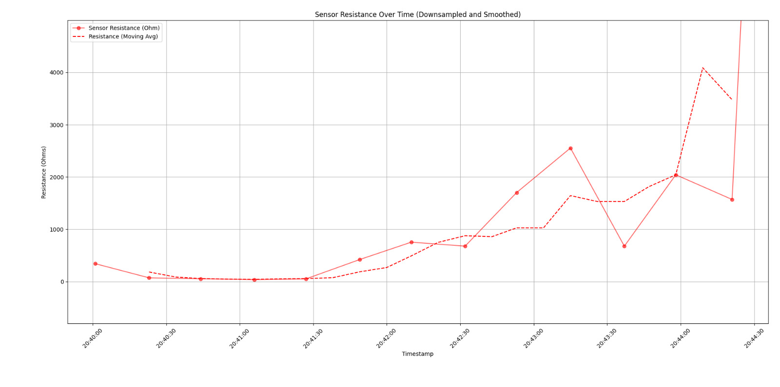
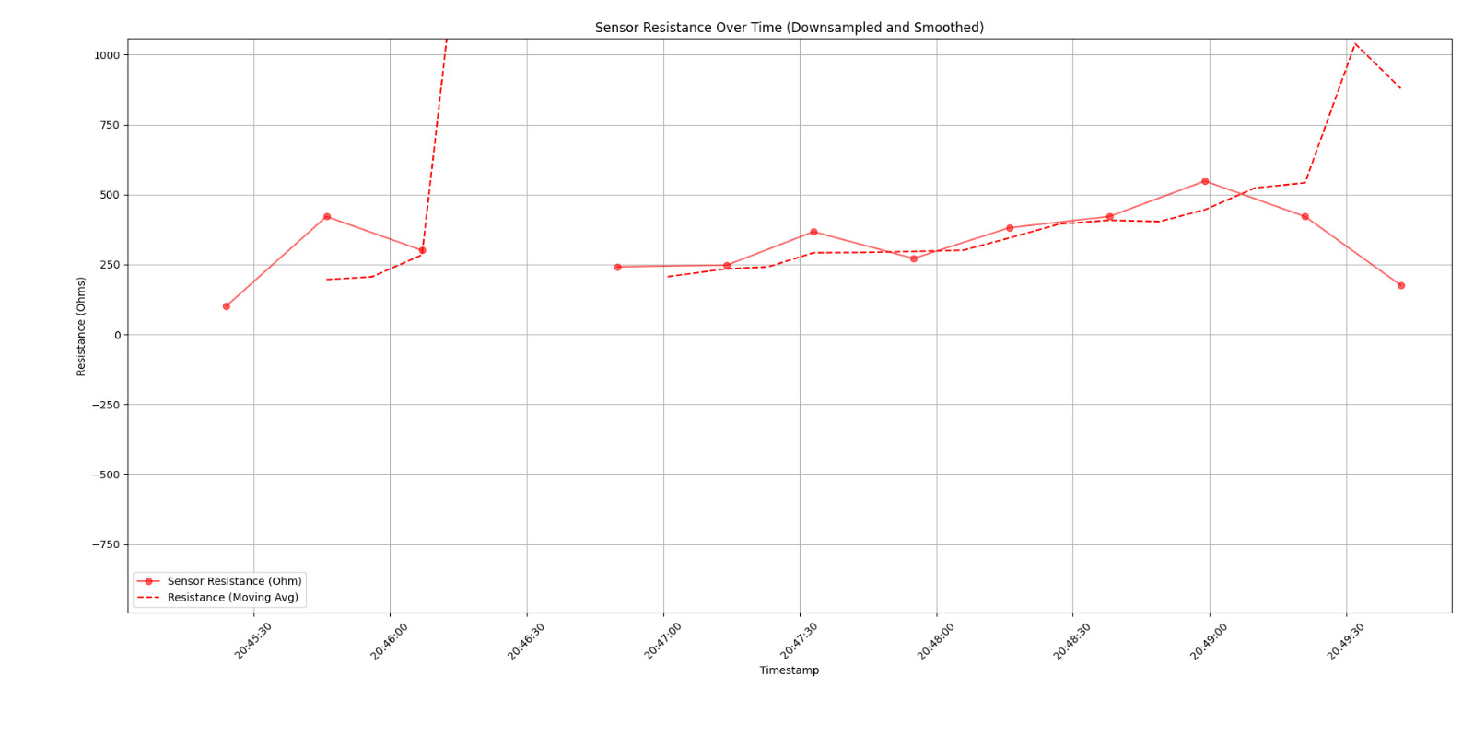
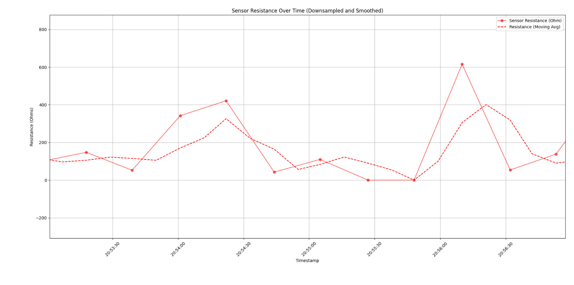

Slide 24
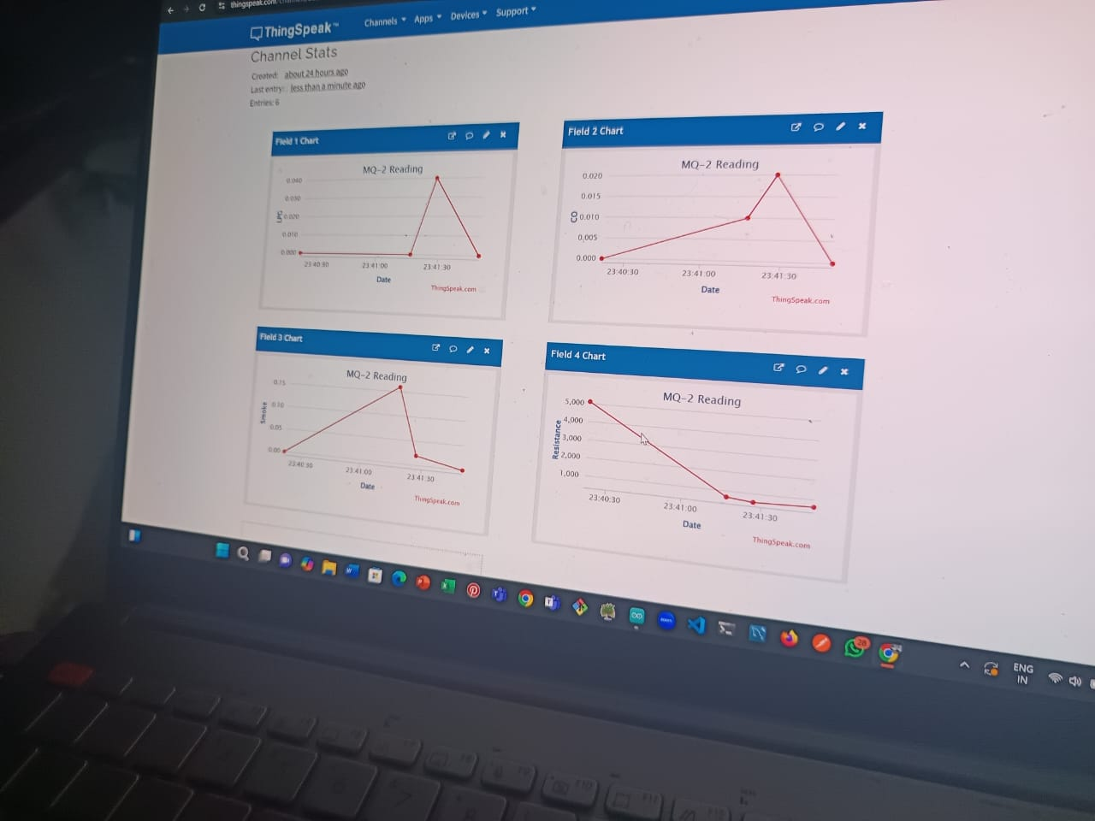

Slide 25
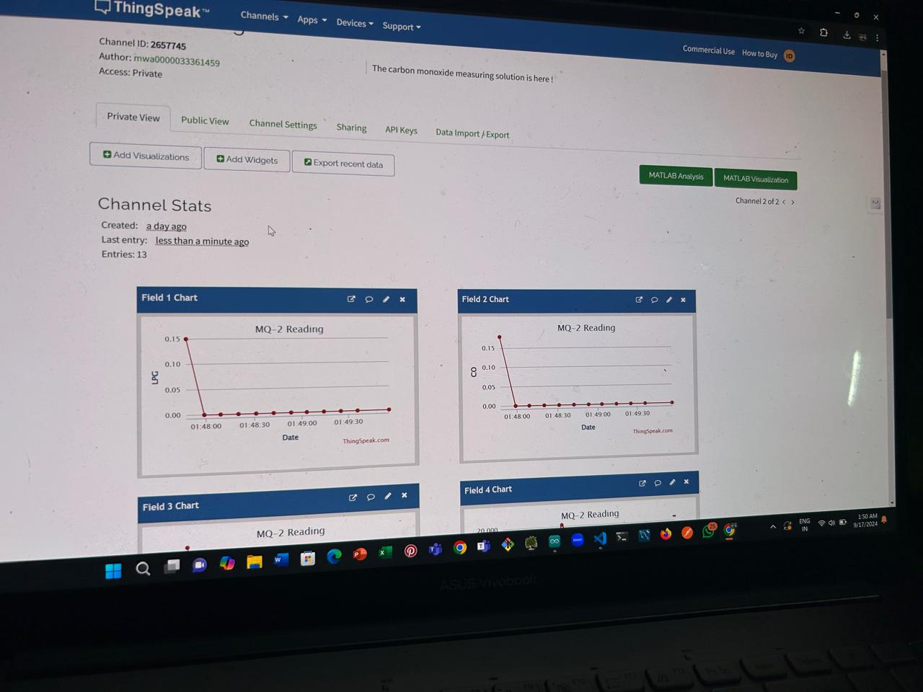

Slide 26
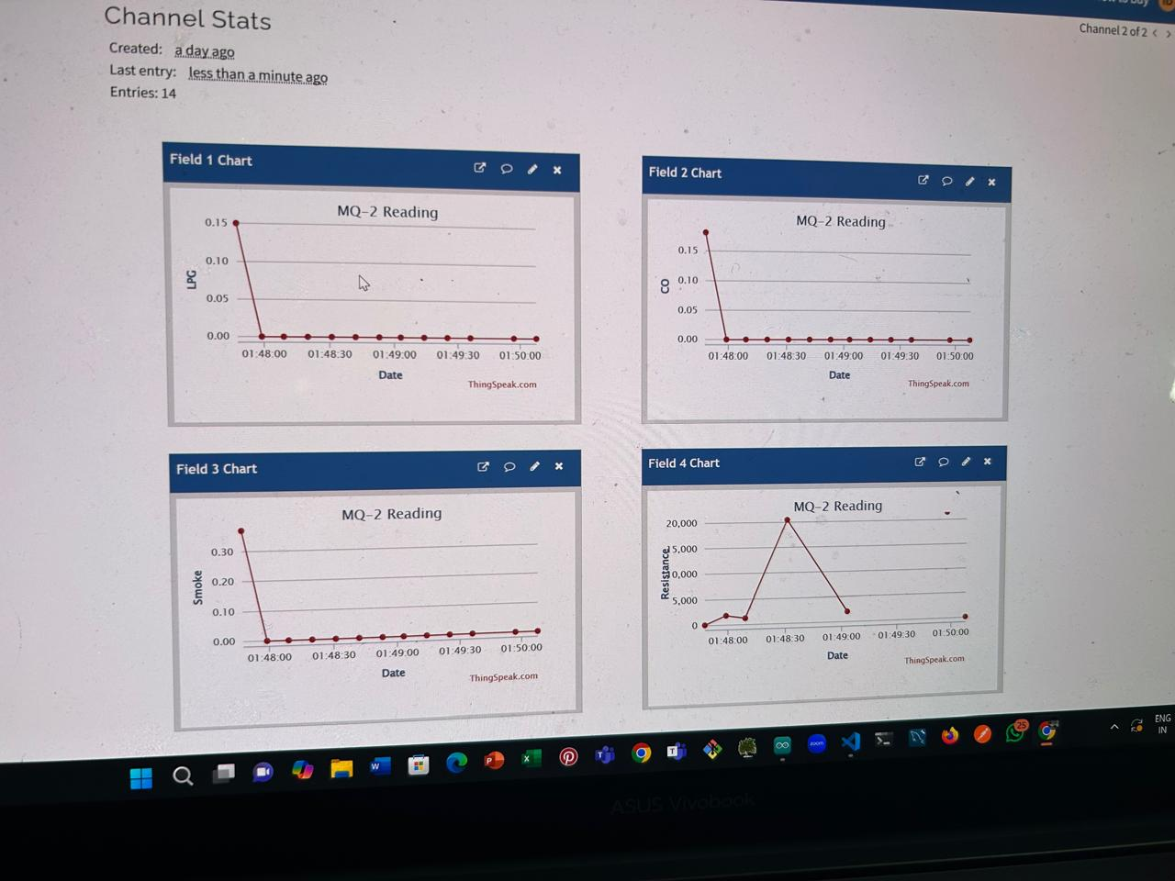

Slide 28
Targets for next week
Objectives:
Integration of actuators: will try to integrate DHT 11 sensor (next slide for plot) A lot of data collection will be done under controlled environment and a variety of different settings A minimum viable GUI of the platform will be made. Precise R(l) measurements will be made for future purposes and readings.

Slide 29
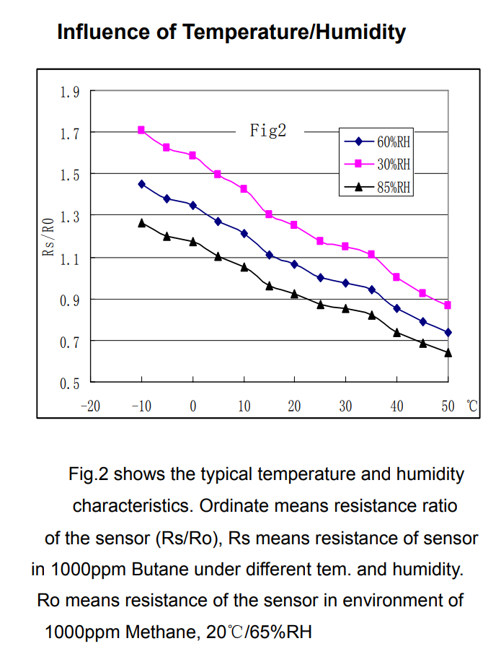
DHT 11 Integration plan:

